Slide 1
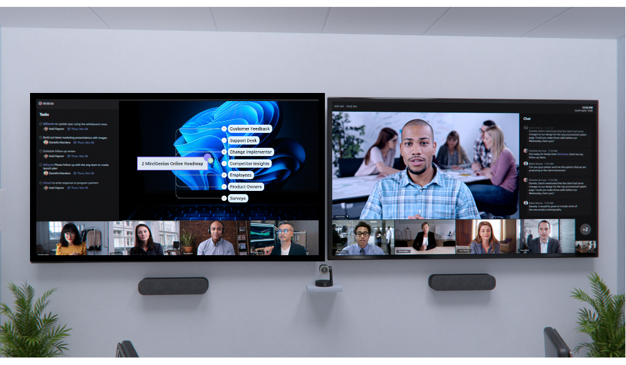
MindGenius Online for Microsoft Teams
Empower hybrid workers with collaborative mind-mapping apps in Teams

Slide 2
Agenda
Microsoft Teams powers hybrid work collaboration
MindGenius Online for Teams
See it in action: MindGenius Online for Teams

Slide 3
Hybrid work is here to stay
80%
of leaders say they plan to make major changes to their flexible work policies¹
73%
of employees want flexible remote work options to stay1
1 Microsoft Work Trend Index Annual Report 2021
Notes:
Hybrid work context setting
State research that supports the notion that hybrid work is here to stay
Leave this slide as is

Slide 4
Hybrid workplaces are disconnected
Customers need to capture the best ideas
25X
Customers need to collectively prioritise the ideas to decide the best way forward
On average, information workers switch between 10 apps up to 25 times a day²
Customers need to have clarity on how best to action the plan
2 Microsoft Research + Insights Asana Anatomy of Work Index, 2021
Notes:
Hybrid work context and challenge
Heading: broad context
Set the context of hybrid work and challenges to collaboration that customers encounter.
For example, if you have an app that improves sales team collaboration, a header could read “Remote selling is the new reality in hybrid work”
Bullets: specific challenges
List specific challenges that your application in Teams helps to solve.
The challenges can be tailored to specific teams within a business.
The challenges should be directly addressed by the benefit pillars slide and throughout the presentation.

Slide 5
Create a collaborative business improvement team environment in Microsoft Teams
Meet
Chat
Stay organized with teams and channels
Schedule and conduct team meetings
Quickly share and access files
Add apps in Teams to expand collaboration
Call
Collaborate
Integrate
Notes:
Microsoft Teams capabilities
Ensure the audience is informed on essential ways they can drive collaboration using Microsoft Teams
Customize the title to a specific business team that benefits the most from your solution (sales, marketing, IT, etc.)

Slide 6
Microsoft Teams together with MindGenius provide the ideal platform to let interested parties identify, collaborate and prioritise where effort is best rewarded. Helps ensure we continually do the right things and do them right.
Creating a unique workspace for you and your team to collate and develop ideas
So, why should you use MindGenius Online inside Microsoft Teams?
Organize, evaluate, and prioritize according to your criteria, using a variety of powerful visual tools
Turn ideas into actions — highlighting what's most important, what's needed when, and everyone's workload
Notes:
Unique value proposition and pillars
Make sure to highlight and callout what unique scenarios can the audience achieve using the app inside Teams – something that stands out vs other channels eg: web browser, Android/iOS native apps where users can use your app
Communicate what the audience will be able to accomplish with your collaborative app in Teams
Begin the statement with a verb
Make the statement clear and specific
Include 3 core benefit pillars
Keep these brief
Align the pillars directly to the previously introduced challenges

Slide 7
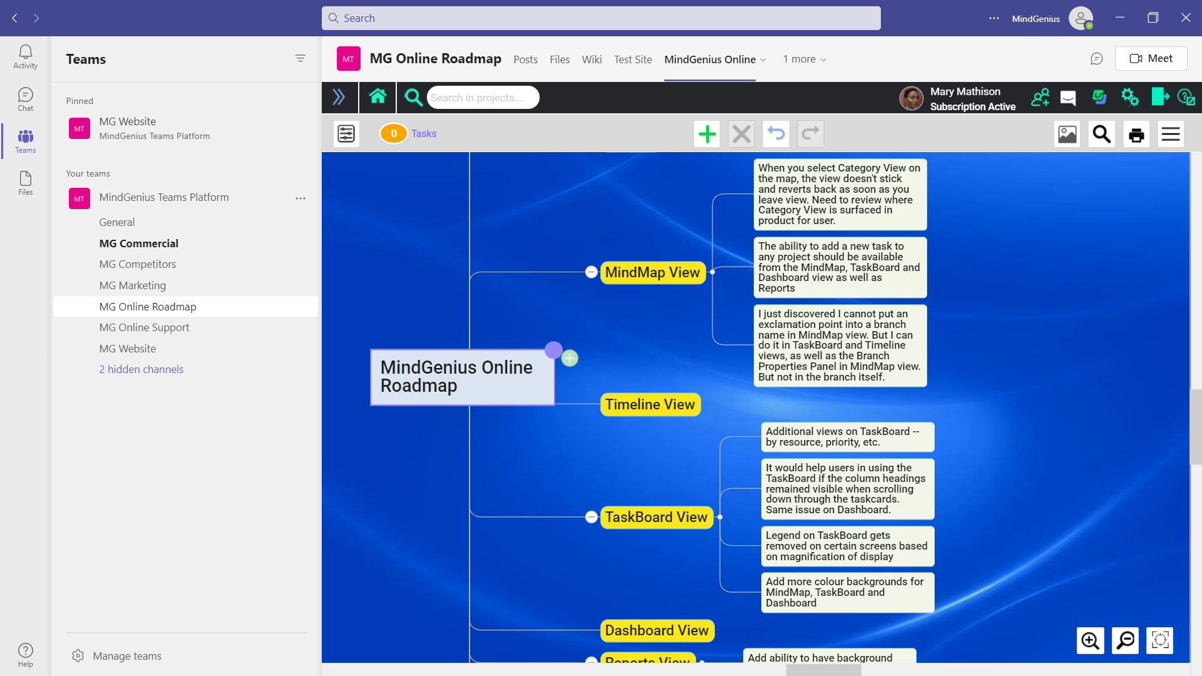
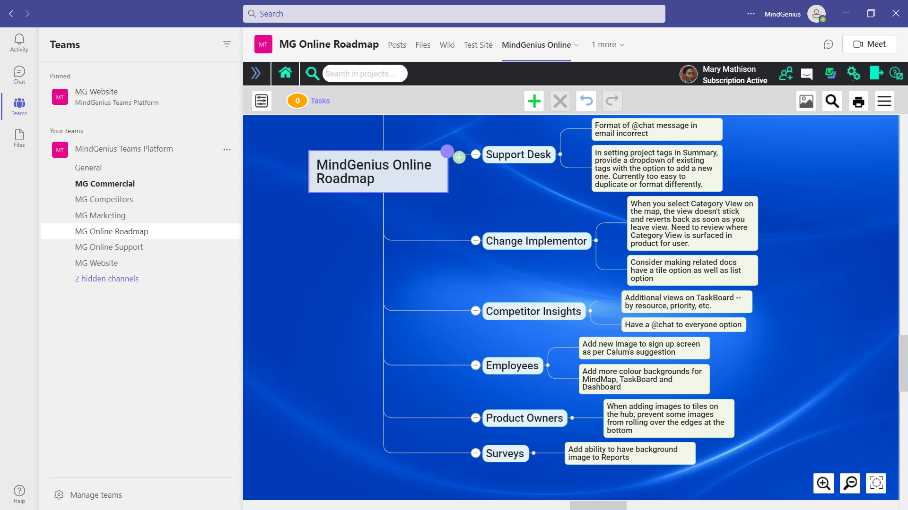
Create a unique workspace for you and your team to collate and develop ideas
Capture ideas and information
Quickly group and order information using drag and drop
Effortlessly add new information
Notes:
Benefit pillar 1
List features of your solution in Teams that support the key benefit
Include a screenshot from the UI in Teams

Slide 8
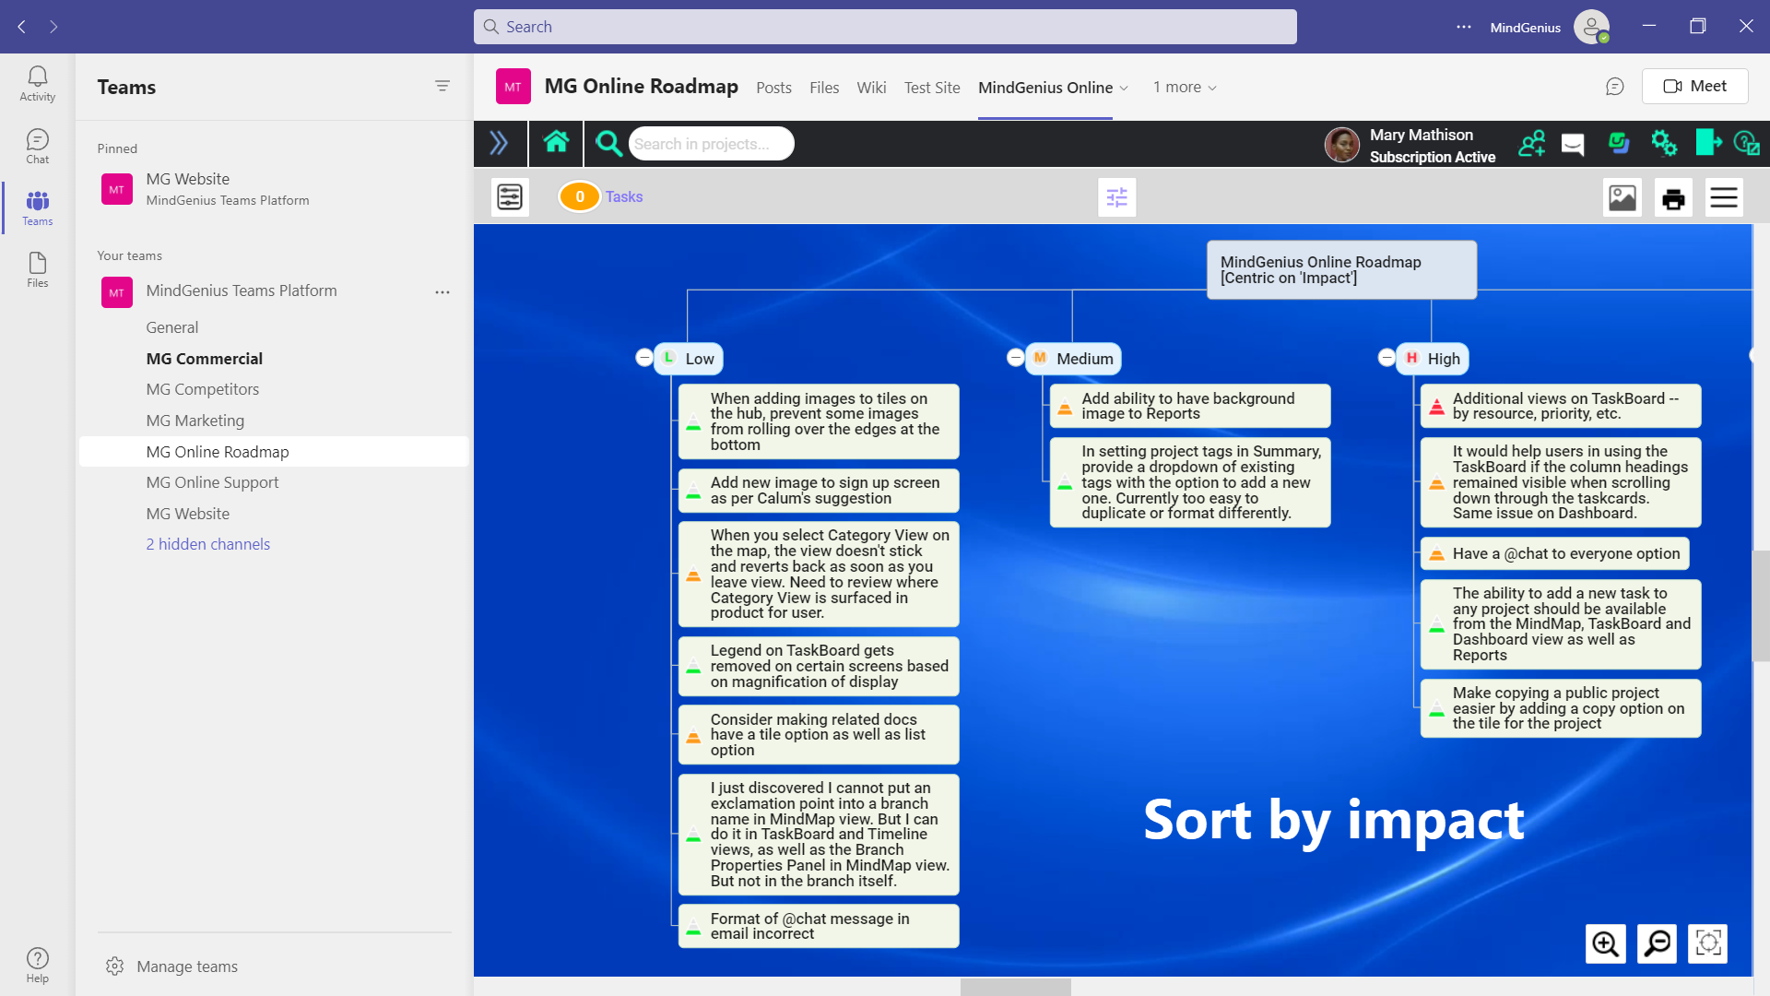
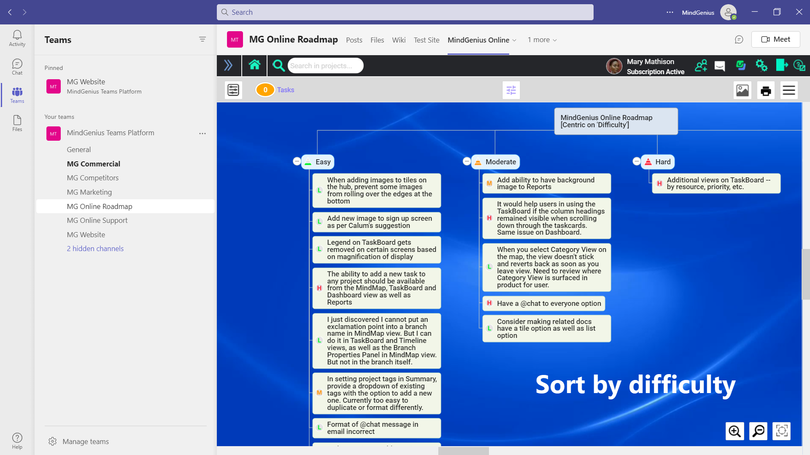
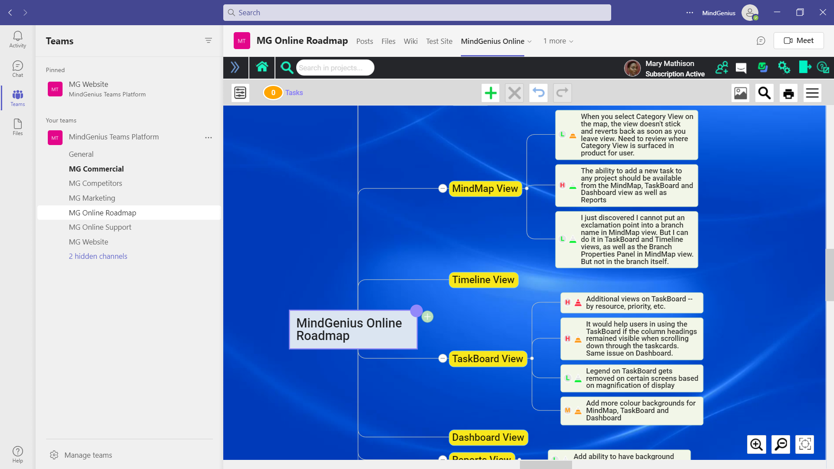
Organize, evaluate, and prioritize according to your criteria, using a variety of powerful visual tools
Assign categories to quickly sort and sequence the information and ideas –based on impact and difficulty (in this example)
Use the Tag Centric View to see where impact and difficulty can help you define the sequence of tasks
Focus on the best ideas
Notes:
Benefit pillar 2
List features of your solution in Teams that support the key benefit
Include a screenshot from the UI in Teams

Slide 9
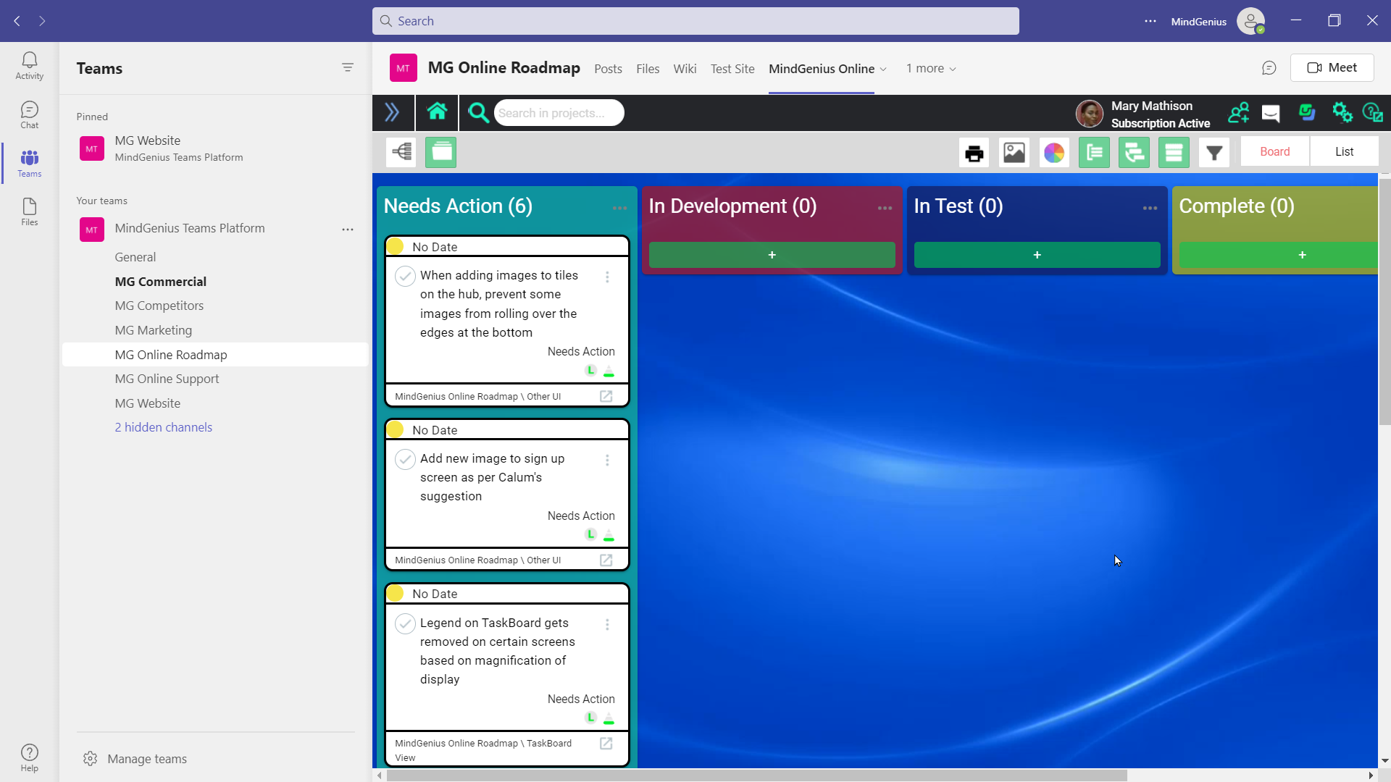
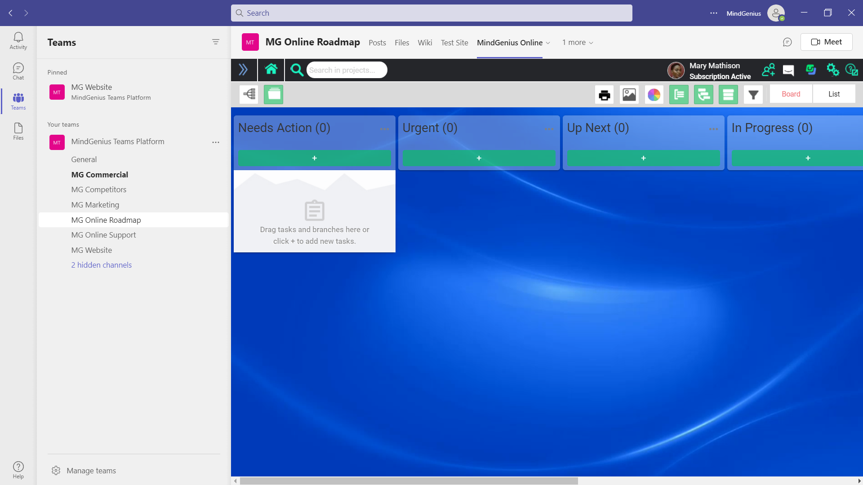
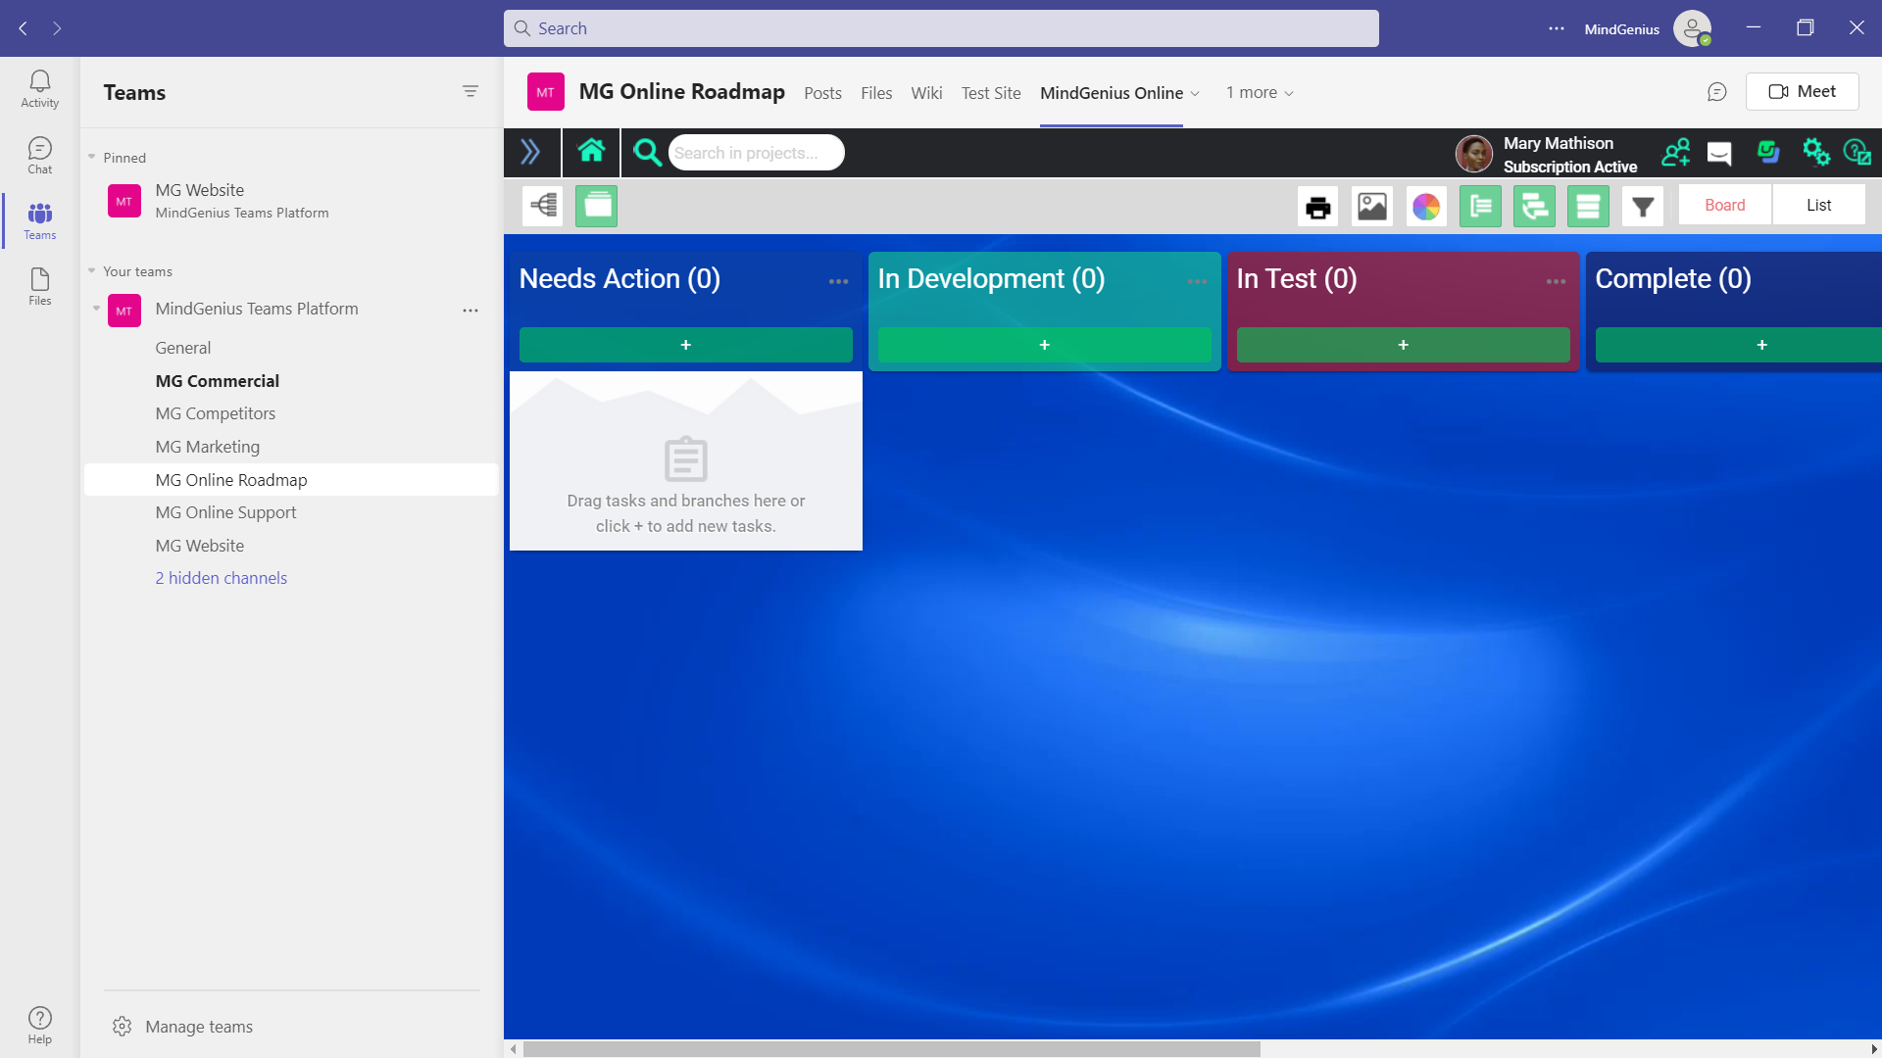
Turn ideas into actions — highlighting what's most important, what's needed when, and everyone's workload
Define your key process stages to ensure tasks are managed to completion
Arrange tasks by your criteria
Drag and drop tasks to track progress
Notes:
Benefit pillar 3
List features of your solution in Teams that support the key benefit
Include a screenshot from the UI in Teams

Slide 10
See it in action: MindGenius Online in Teams
Notes:
Transition
Update to include your solution in the title

Slide 11
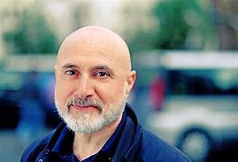
Managing Artificial Intelligence within NHS Universities
“We are using MindGenius Online to allow collaboration on a £850,000, two year artificial intelligence project involving NHS, University’s and industry partners located across the UK. MindGenius Online’s ability to switch views between mindmap, taskboard and GANTT timeline has impressed many of the partners involved, and has clearly won over new admirers used to more expensive solutions with less functionality.”
Results
To complete business objectives that are simply not possible to achieve when constrained by people, cost or time
Improve communication within remote workers as 88% struggle with miscommunication or inconsistent practice
Danny Ruta
A1 Clinical Lead – Guys Cancer
Notes:
Customer success story
Mention the customer in the slide title along with information about how they benefited from your solution in Teams
List concrete results, ideally including quantitative data
Provide a quote from the customer along with their name

Slide 12
Insert partner logo
MindGenius Online for Microsoft Teams
Personas in this demo
Ashley Marron – CEO
Donald Maciver- Product Manager
Calum Bateman - Marketing
David Lenthall - Development
https://www.youtube.com/watch?v=SGQaCqiZTf8
Business Context in this demo
Team requires to brainstorm, and agree the priorities for the product roadmap for next quarter when considering ideas from several different sources.
Notes:
Demonstration
Include a demo video or live-action demonstration

Slide 13
Microsoft Teams together with MindGenius provide the ideal platform to let interested parties identify, collaborate and prioritise where effort is best rewarded. Helps ensure we continually do the right things and do them right.
Creating a unique workspace for you and your team to collate and develop ideas
Organize, evaluate, and prioritize according to your criteria, using a variety of powerful visual tools.
Turn ideas into actions. Visually highlight what's most important, what's needed when, and everyone's workload
Notes:
Recap solution integration benefits
Summarize how your solution in Teams will create positive customer outcomes

Slide 14
Get the app now
1
Visit Teams App Store to get started with MindGenius Online for Microsoft Teams
Learn more
Visit AppSource to see the app details and experience screenshots
Notes:
Call to action
Update this slide to include the AppSource link to your solution

